Slide 1
Understanding Judicial Responses to Political Stability: A case study of Vanuatu and Papua New Guinea
Bal Kama
PhD Candidate, Australian National University
Lecturer, University of Canberra Law School
Email: bal.kama@anu.edu.au

Slide 2
OUTLINE
INTRODUCTION
WHAT IS POLITICAL STABILITY?
CASES AND JUDICIAL RESPONSES
WHY A ‘STRONG’ RESPONSE?
CHALLENGES TO REFORMIST JUDICIAL OPINIONS
FUTURE PROJECTIONS

Slide 3
INTRODUCTION
Research interest – to understand the relationship between the judiciary and the executive arms of government under the PNG Constitution.
A socio-political perspective of judicial functions in relation to the other two arms of government.
Methodology – cases analysis and field research in PNG, 2016.
Key Questions:
  Why do courts need to respond unreservedly to political concerns?
  If courts play a central role in ushering political stability, is there a need to rethink the traditional expectations?
  What are some challenges for politically reformists courts?

Slide 4
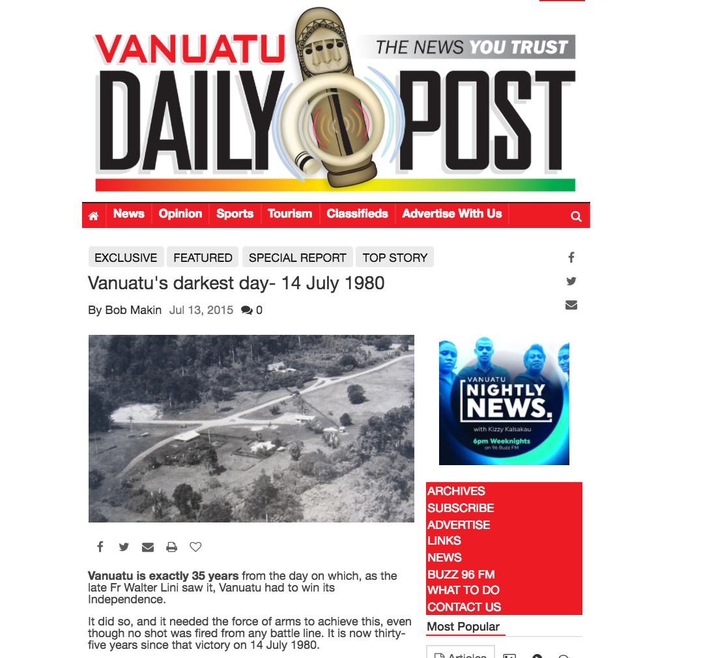
21 Oct 2015 – Brightest Day?

Slide 5
WHAT IS POLITICAL STABILITY?
‘political instability is the propensity of a government to collapse…’ (Alesina, Alberto et al, Harvard, 1996)
An important cause of ‘political instability’ is ‘an all-powerful executive interacting with a totally irrelevant [parliament].’ (Levitsky and Murilo, 2005, 60)
Familiar terms in Melanesia: ‘arch of instability,’ ‘weak state,’ or ‘fail state’.
  ‘arch of instability’ – ‘encapsulated growing Australian concerns about the political cohesiveness of Melanesian politics…’ (Robert Ayeson, 2007, in Australian Journal of International Affairs)

Slide 6
What is the kind of ‘Melanesian Politics’ covertly referred to by Ayeson?
  Described what appeared to be a set of fluid governance structures that is often unable to contain political contestations, the constantly shifting allegiance of political parties, the unpredictability of political actors and the perceived intrusion upon the functions of state agencies by the executive which ultimately compromises institutional independence and efficiency.
Questions the constitutional democracy project.
Challenge: To curb an all-powerful executive.
Two critical issues:
  Constitutional breaches
  Corruption

Slide 7
CASES AND JUDICIAL RESPONSES
PAPUA NEW GUINEA
Namah v O'Neill [2015] PGSC 77
  Vote of no-confidence issue: Whether amendments to extend the grace period for VoNC to 30 months from 18 months are valid?
Supreme Court:
  Amendments was an attempt to entrench power and autocratic rule [42].
  Accepted that:
    “political stability may be politically reasoned… [however] excessive stability often leads to dictatorship. It does promote hunger for power. Stability must not be for the purpose of protecting a bad or corrupt government to remain in power…[and] remains untouchable for the specified ‘grace period’.” (Namah v O'Neill [2015] PGSC 77[6,7]. (slide)

Slide 8
Reference to Constitution section 19(1) by East Sepik Provincial Executive [2011] PGSC 41
  Constitutional impasse – ‘two’ Prime Ministers and an embattled Chief Justice
Court: Michael Somare’s government an ‘executive dictatorship’:
  “There appeared to be a growing dominance of and over parliament by the executive. A creeping tyranny of the majority (sic) seemed be the order of the day…” [604]
Similar inferences have been made against Prime Minister Peter O’Neill in recent cases.

Slide 9
Concerns raised on how important constitutional amendments were “rushed” though Parliament: (Manus Island case, 2016).
The drafters of the PNG Constitution:
  “We believe that while the executive must be given every opportunity to provide strong leadership in reshaping our new nation to meet the needs and aspirations of our people, it is important also that this leadership does not become autocratic so that the legislature becomes a mere rubber stamp.” (CPC Report, 1975, Chapter 6 [1]

Slide 10
Reference to Constitution section 19(1) by East Sepik Provincial Executive [2011] PGSC 41
  “The Courts have power to control Executive acts and take up such issues without fear or favor within the strict confines of the powers given by the Constitution, bearing in mind that the Courts are co-agents of the people. Abuse of power by the [Executive] NEC must not be tolerated by the Court.” [372] per Deputy Chief Justice G. Salika.

Slide 11
VANUATU
  Natuman v President of the Republic of Vanuatu; Vohor v President of the Republic of Vanuatu [2015] VUSC 148; Constitutional Case 6 & 7 of 2015 (21 October 2015)
Speaker used his position as Acting President to grant pardon to himself and 13 other convicted MPs.
Was it a valid use of power?
  Valid use under Article 38 but a breach under Article 66 (conflict of interest).

Slide 12
Public Prosecutor v Kalosil - Sentence [2015] VUSC 149; Criminal Case 73 of 2015 (22 October 2015)
  14 MPs, including former Deputy PM and Speaker convicted of bribery and corruption.
  Sentenced to 2-4 years and dismissed from Office.
  Vanuatu went to early elections

Slide 13
SOME KEY SIGNIFICANCE:
  First the time in the Pacific for almost half of government MPs to be jailed.
  The political reform process was instigated (election).
  Clear Message: Corruption comes with a hefty price.
    Underlying concerns with 27 attempts of VoNC since 1980 (Transparency International Vanuatu)
    Former PM Natuman: “vote of no confidence is a norm, its automatic.” (Kalosil case, 2015)

Slide 14
SOME KEY SIGNIFICANCE:
By a foreign judge
  ‘hard case’
By a female judge
  Challenge Melanesian perceptions of woman
  “…corruption offences, if left unchecked, can quickly erode and eventually undo the work ethic of public officers in any nation. Needless to say that a Government cannot survive, no matter how good its aims and intentions are, if corruption exists within its ranks.” Justice Mary Sey at [21]
Speedy resolution of a high profile case.

Slide 15
WHY A ‘STRONG’ RESPONSE?
Judicial decisions increasingly infused with political commentary, especially PNG cases.
Hardline judgments encapsulate the judiciary’s innate political frustrations as much as their legal justifications for righting the wrong.
Opinions seemed to be tailored to instigate social and political reform, as well as changes in attitudes and perceptions.

Slide 16
CHALLENGES TO REFORMIST JUDICIAL OPINIONS
Legalism
  Courts – restricted role, non-political function.
  Institutional argument
    let state agencies police the government, not courts. (Prof. Goldsworthy)
  Effect on the ‘professional sensibilities, habits of mind and intellectual reflexes’ of judges and lawyers. (Justice Kirby, Australian High Court)

Slide 17
‘Unethical’ lawyering and judicial complacency
  Delay tactics, interlocutory injunctions ect.
  Justice Mary Sey, Vanuatu Supreme Court:
      “I trust that defence counsel will acquaint themselves with relevant provisions relating to Appeals to the Court of Appeal as enacted by Parliament and refrain from causing unnecessary delays of this criminal trial by indulging in strings of appeals which have no legal foundation.” Public Prosecutor v Kalosil [2015] VUSC 121 [11].

Slide 18
Warning for courts against tolerance and complacency:
  “The courts may unwittingly be protecting those with something to hide rather than protecting the more legitimate interests of those with a right to know: the People of Papua New Guinea.”
  Gelu, Lupari and Liu v Somare [2008] PGNC 166; N3526 (17 November 2008)[12] per Cannings J.

Slide 19
  Resistance from parliament/executive
  Tension
  Deputy Chief Justice:
    “In PNG I have not seen any evidence of a public official including leaders voluntarily resign or step aside from office after being criminally charged or charged under the Leadership code. "Innocent until proven guilty" is the new catch word in Papua New Guinea.”
    In re Reference to Constitution section 19(1) by East Sepik Provincial Executive [2011] PGSC 41; SC1154 (12 December 2011)[212]

Slide 20
Weak accountability institutions
  Police
  Ombudsman Commission
  Public Prosecutor
  Parliamentary Committees
  Reference to Constitution section 19(1) by East Sepik Provincial Executive [2011] PGSC 41[520-522]; PNG PM Case, 2016.
Judicial Tenure
Funding

Slide 21
FUTURE PROJECTION?
Courts – active agent of socio-political reform?
Increasing need for courts to undertake a politically reformist function against the executive arm.
Working within a socio-politically informed judicial restraint paradigm.
Drafters of the PNG Constitution:
  The judiciary is expected to be “tuned to the wishes of the PNG society”… and apply “judicial ingenuity to do justice.” Courts “do not exist in a vacuum…and like all other government institutions…courts must be politically conscious.” PNG Constitutional Planning Committee Report 1974, Chap.8[4-7]

